Slide 2
Art, Dialogue and the Dialectics of Artificial Intelligence
John Oliver
www.tyler.world/ai

Slide 3
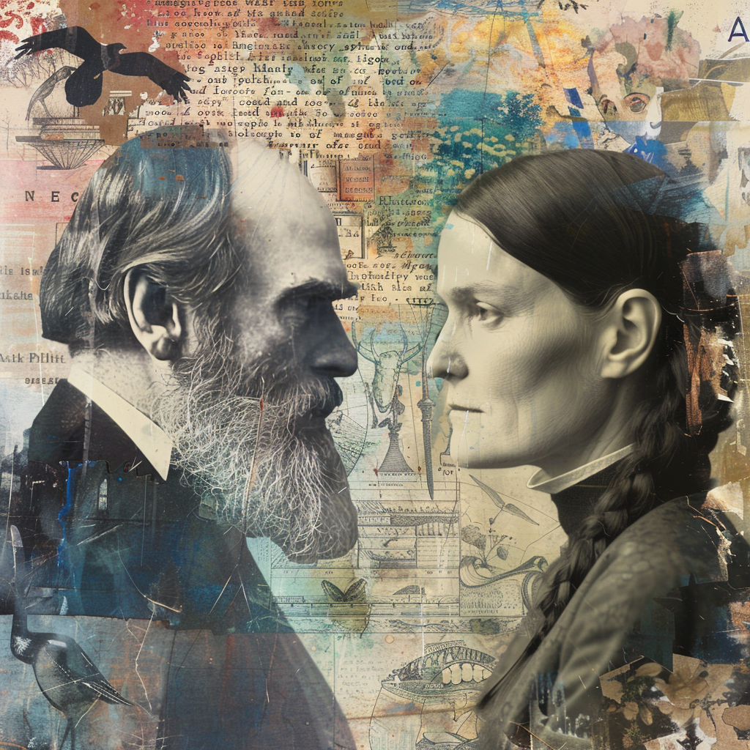
“Meaning-Making” was lost when the Sciences and the Arts split
Charles Darwin
and
Emily Dickinson

Slide 4
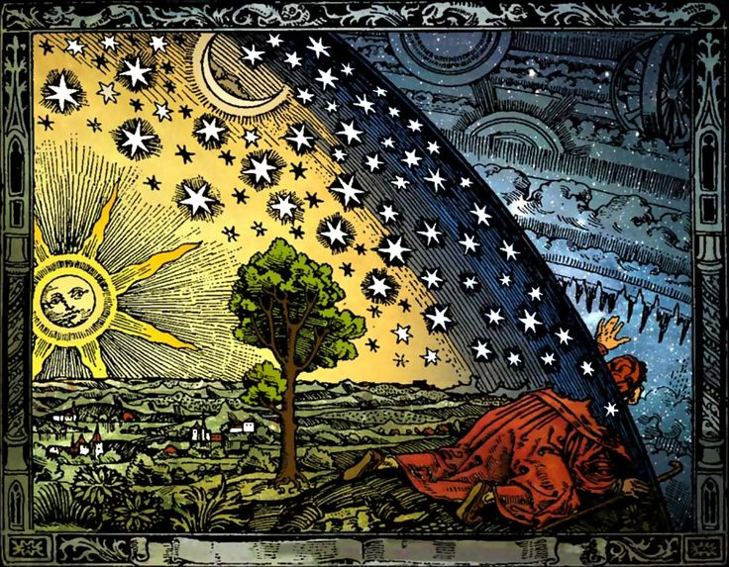
Barrier of Meaning
Urbi et Orbi

Slide 5
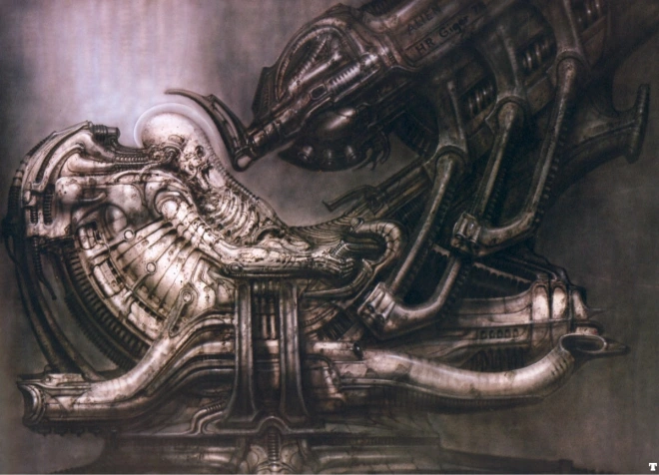
The Space Jockey
H R Giger

Slide 6

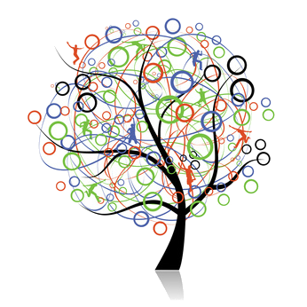
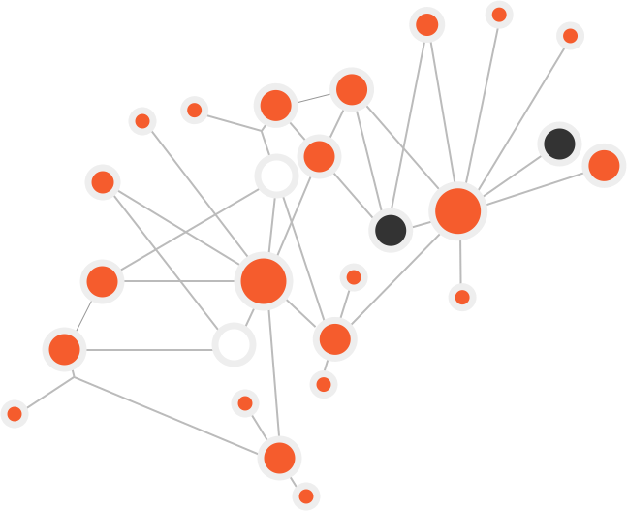
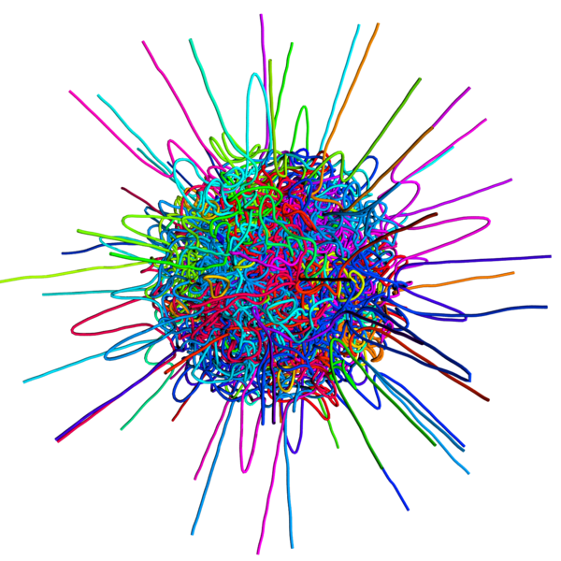
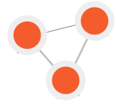
Making Sense of Complexity - Cynefin
1
Complex
Complicated
Chaotic
Obvious / Ordered

Slide 7
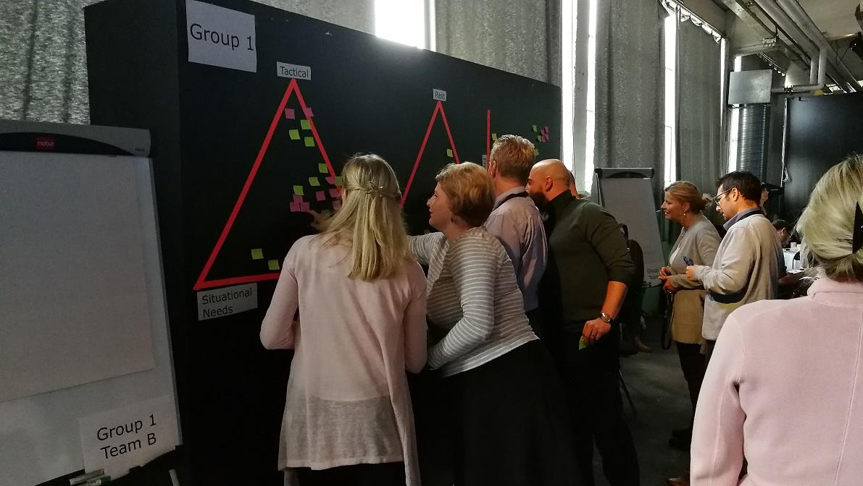
Making sense of the problem we’re seeking to address
Signification Axes
Expert solution
vs
Emergent solutions

Slide 8
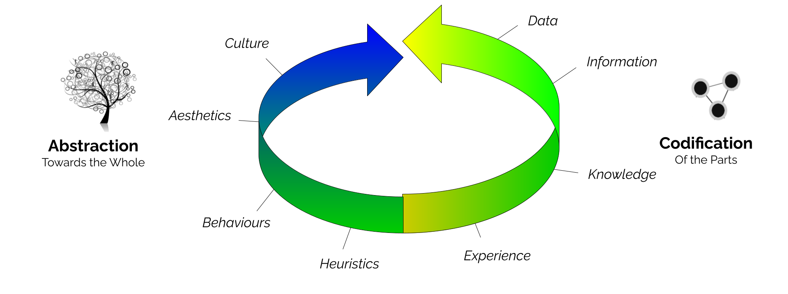
2
Fundamentals of Knowing

Slide 9
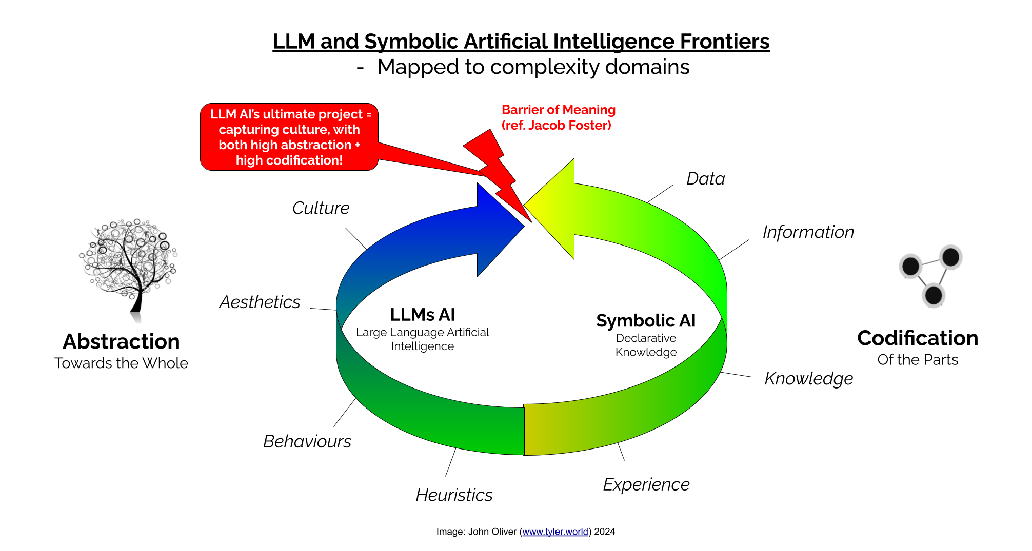

Slide 10
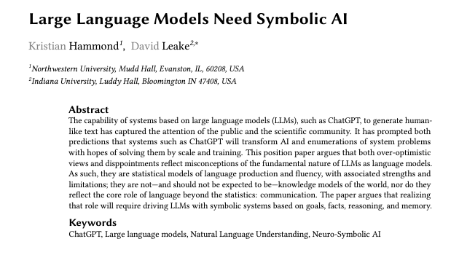

Slide 11
ENVIRONMENTAL AI
emergent sensemaking
AGENTIC
AI
decision
making

Slide 12
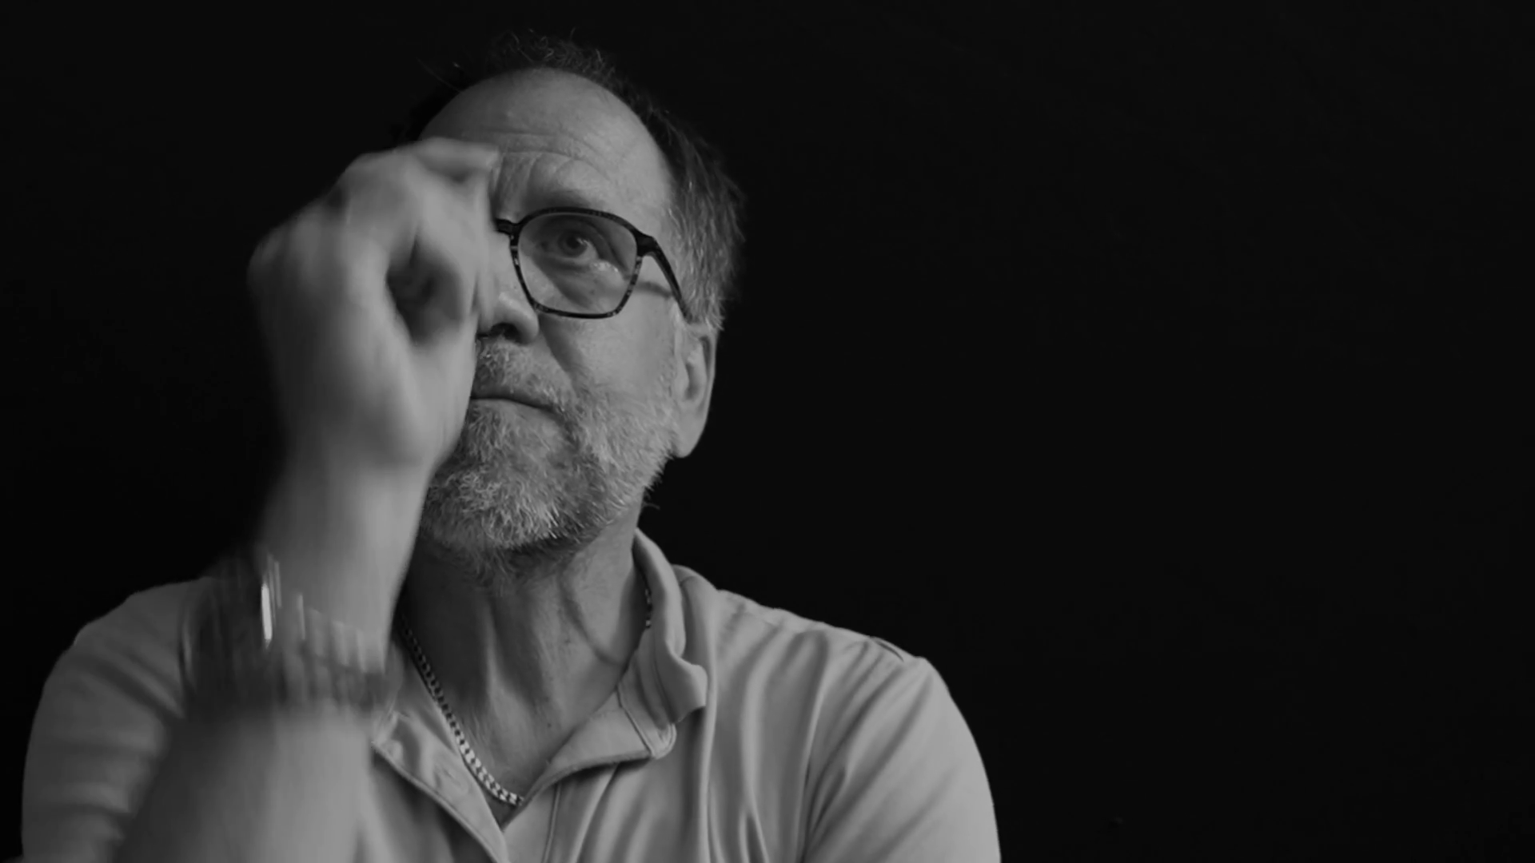
3
Art sits between the arbitrary and the algorithmic
John Vervaeke
InteriorTruth.com portrait 2023

Slide 13
Mapping The Cognitive - John Vervaeke
Perspectival
Cognition
Propositional
Cognition
Participatory
Cognition
Procedural
Cognition

Slide 14
We All Need Artistry
Artificial Intelligence and Complexity Domains - polarities and liminalities
Cynefin Model | ORDERED | COMPLICATED | COMPLEX | CHAOTIC
Modes of Research | Direct analytical knowing |  | Oblique / experiential knowing
 | Search for certainty, prediction |  | Search for form, patterns, meaning
Archetypes | Masculine - yang |  | Feminine - yin
Cognitive Modes | Mathematical formulae | Calculus and algorithms | Symbolic, cultural | Imaginal, aesthetic
 | Extended | Enactive | Embodied | Embedded
 | Procedural | Propositional | Perspectival | Participatory

Slide 15
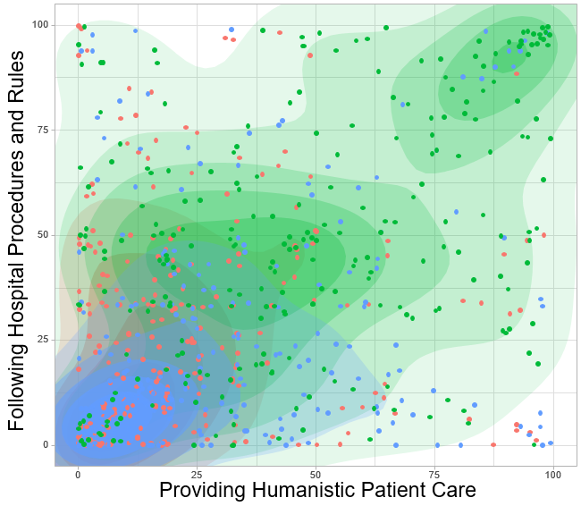
Art As liminal movement between dialecitcs
System 1
System 2

Slide 16

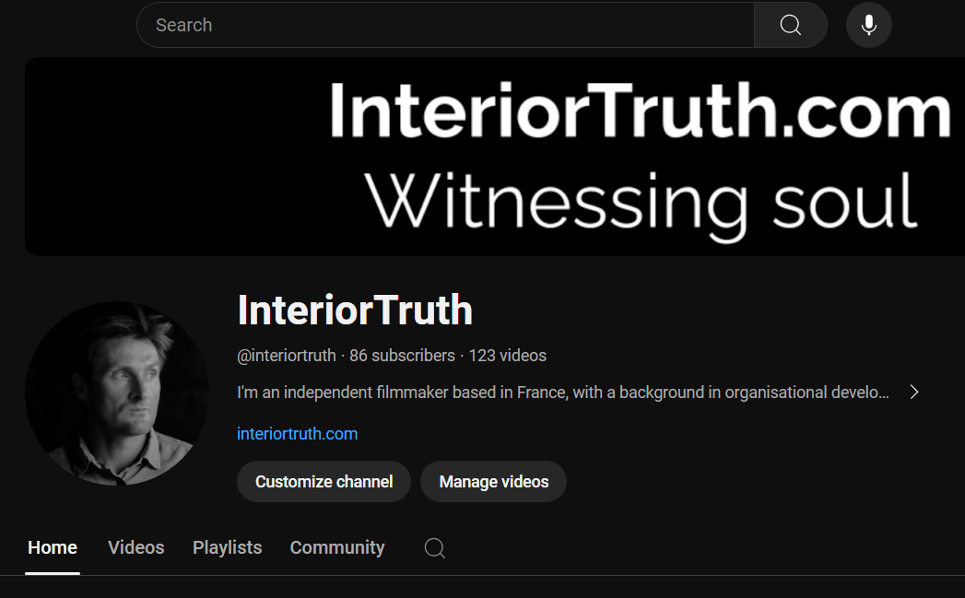

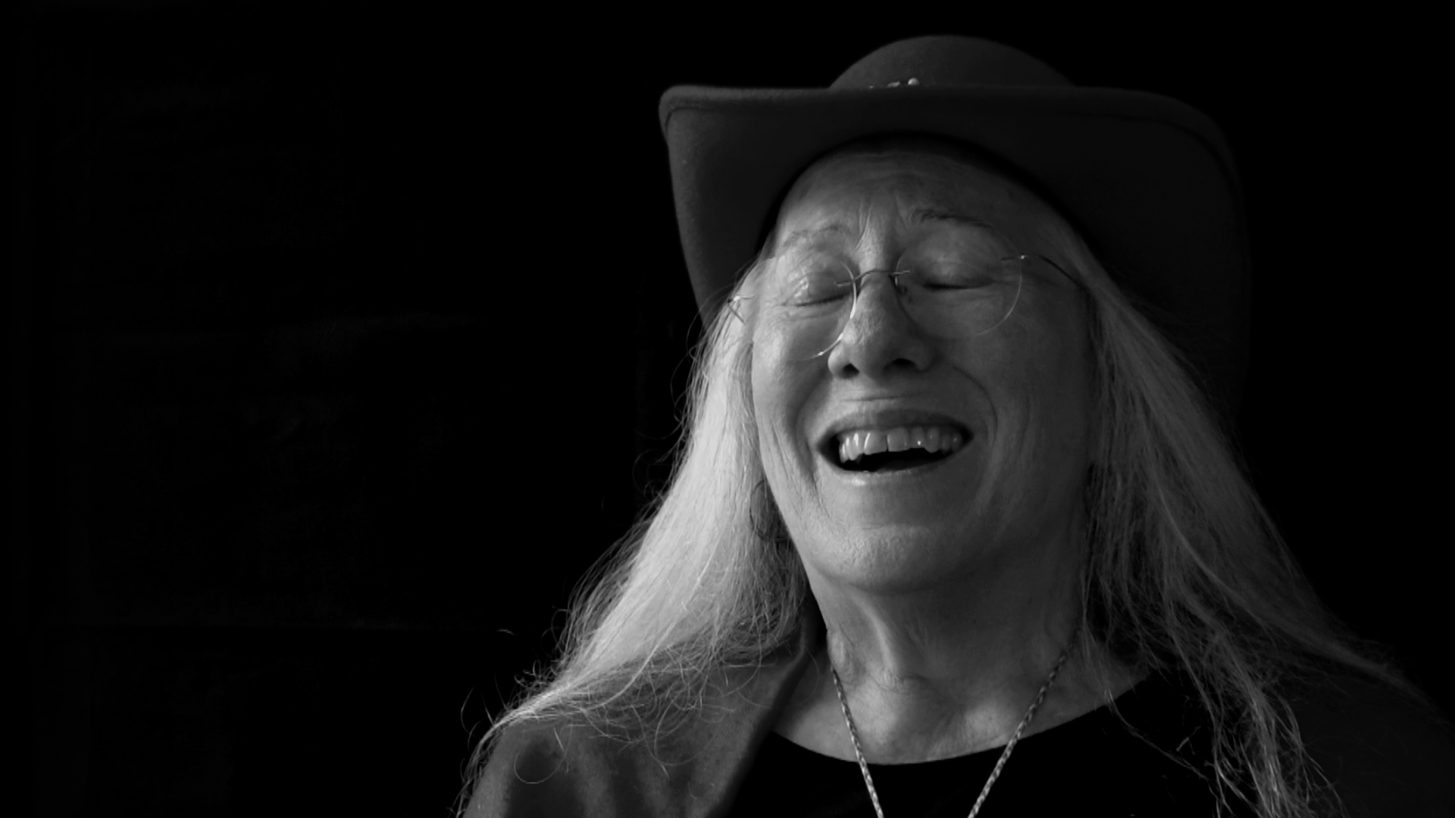
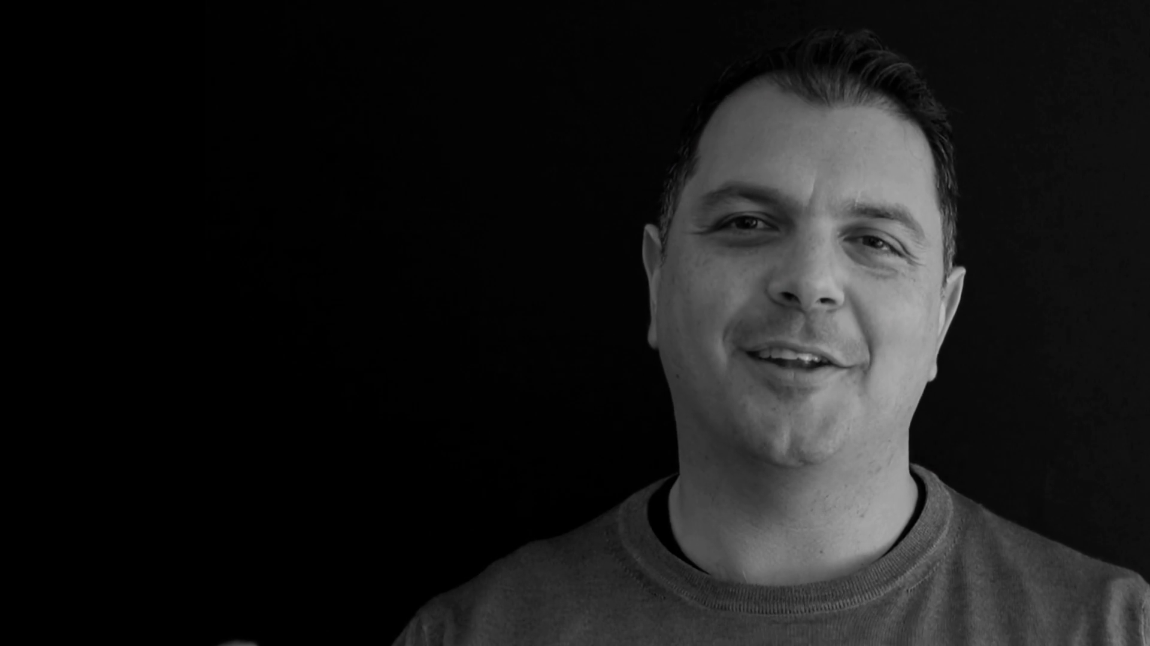
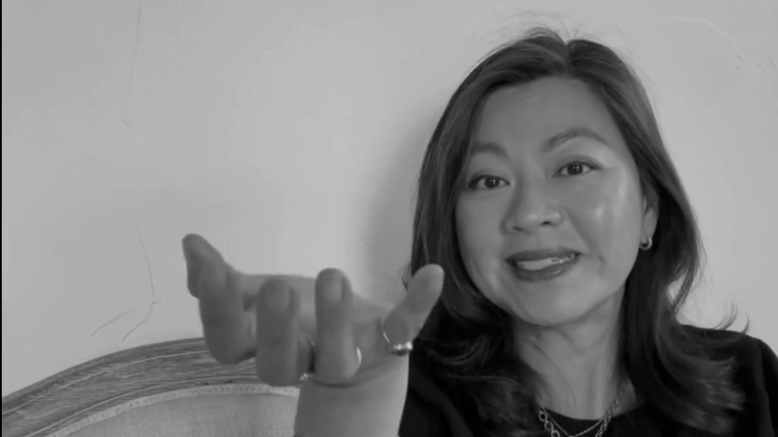
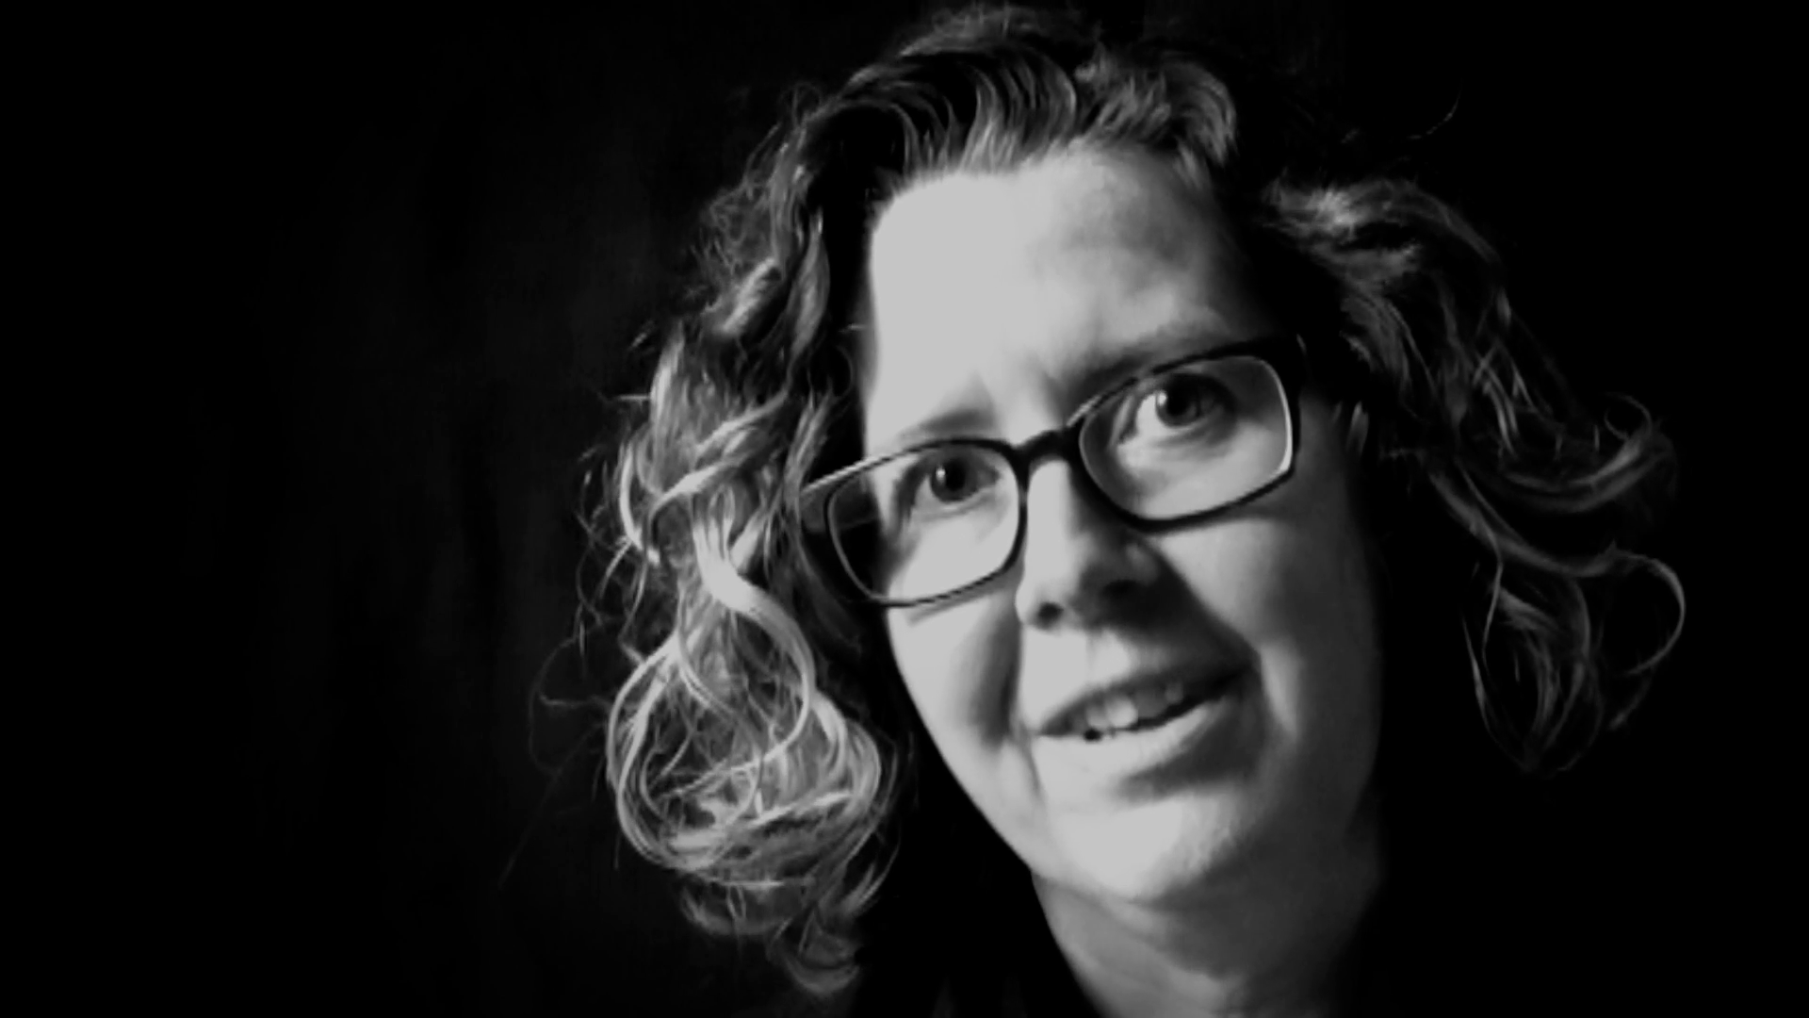
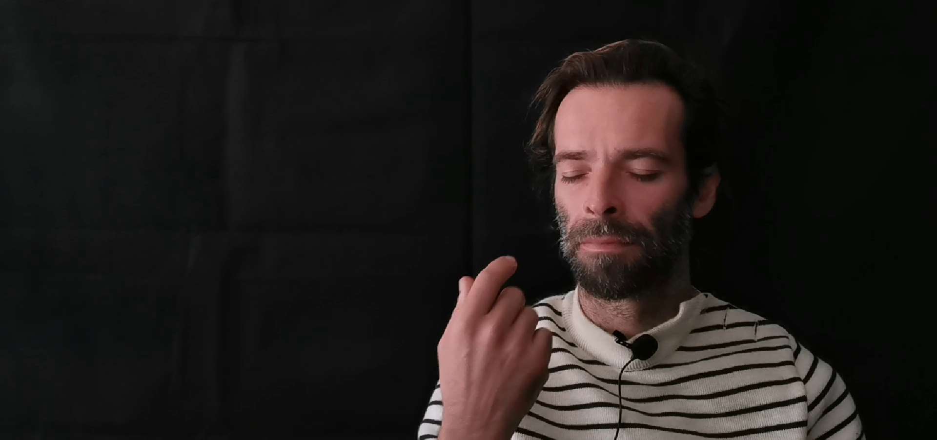
youtube.com/@interiortruth

Slide 17
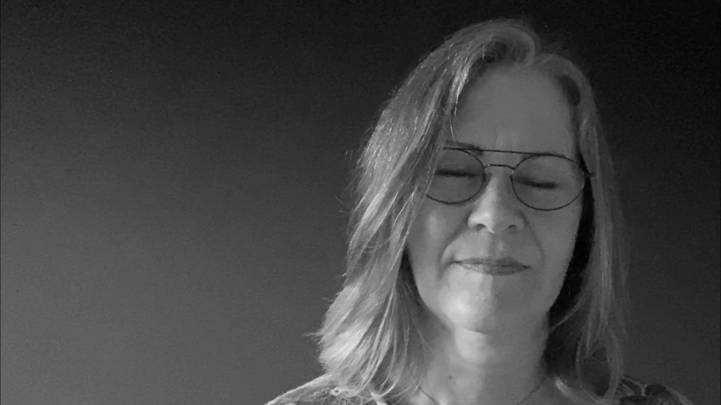
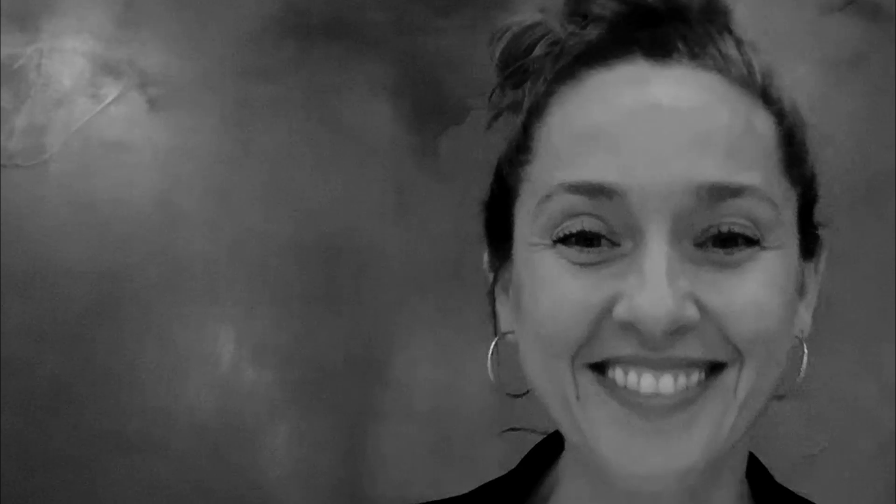
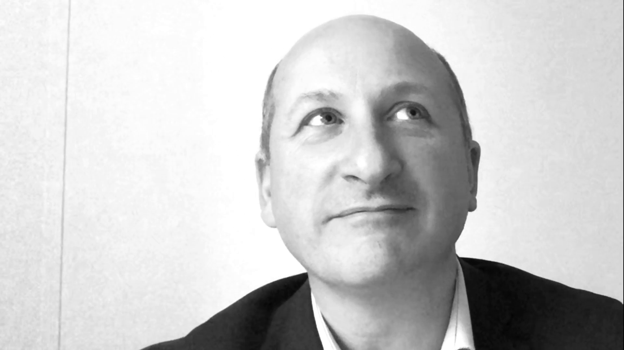
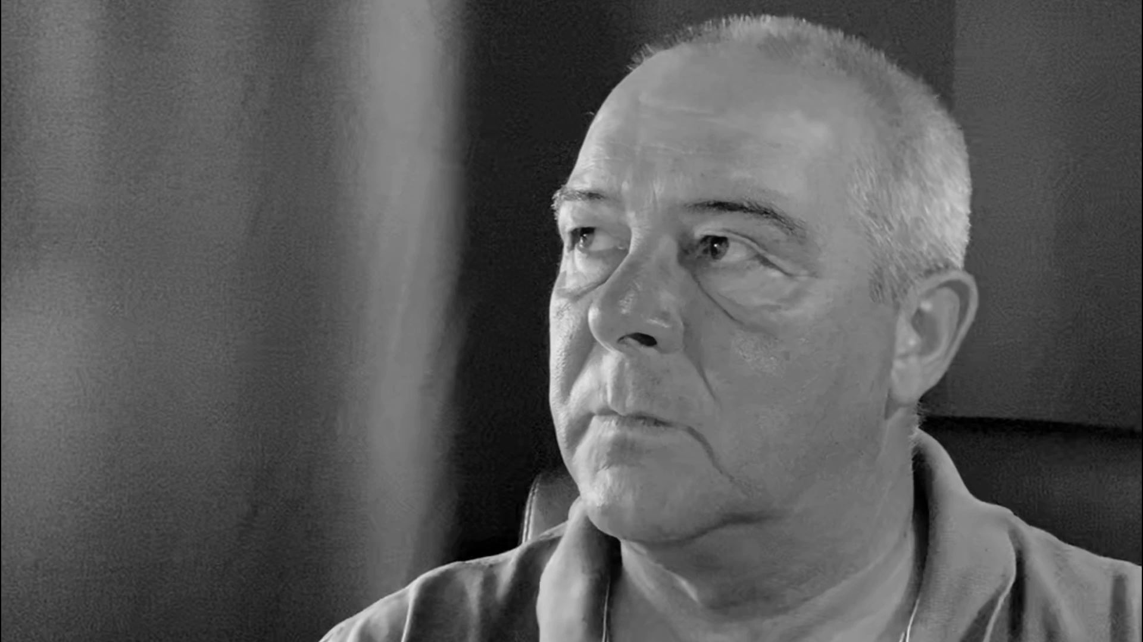
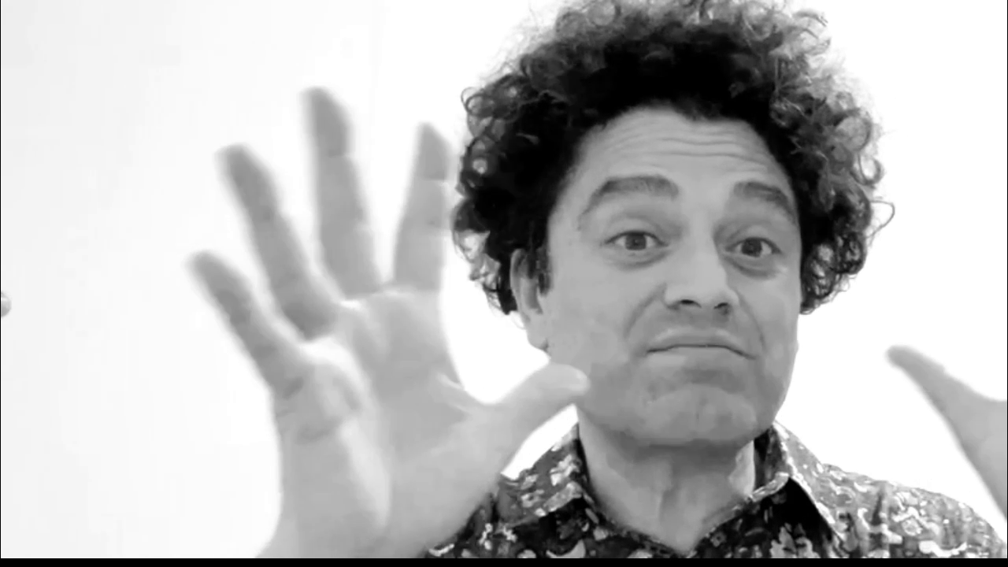
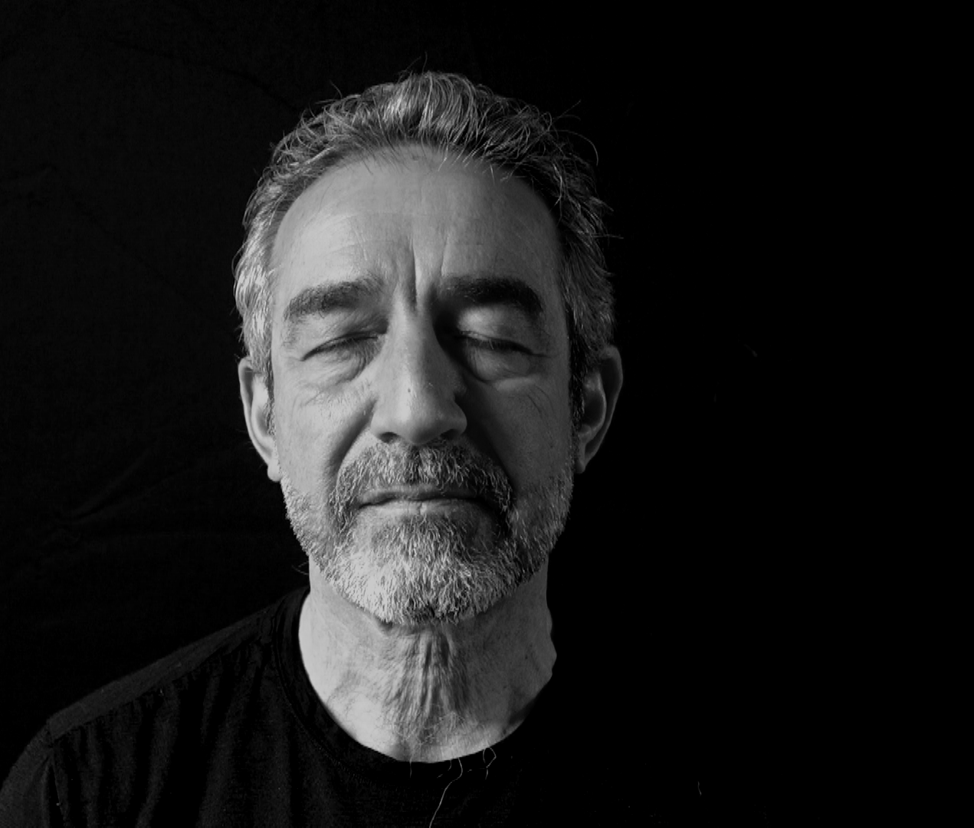
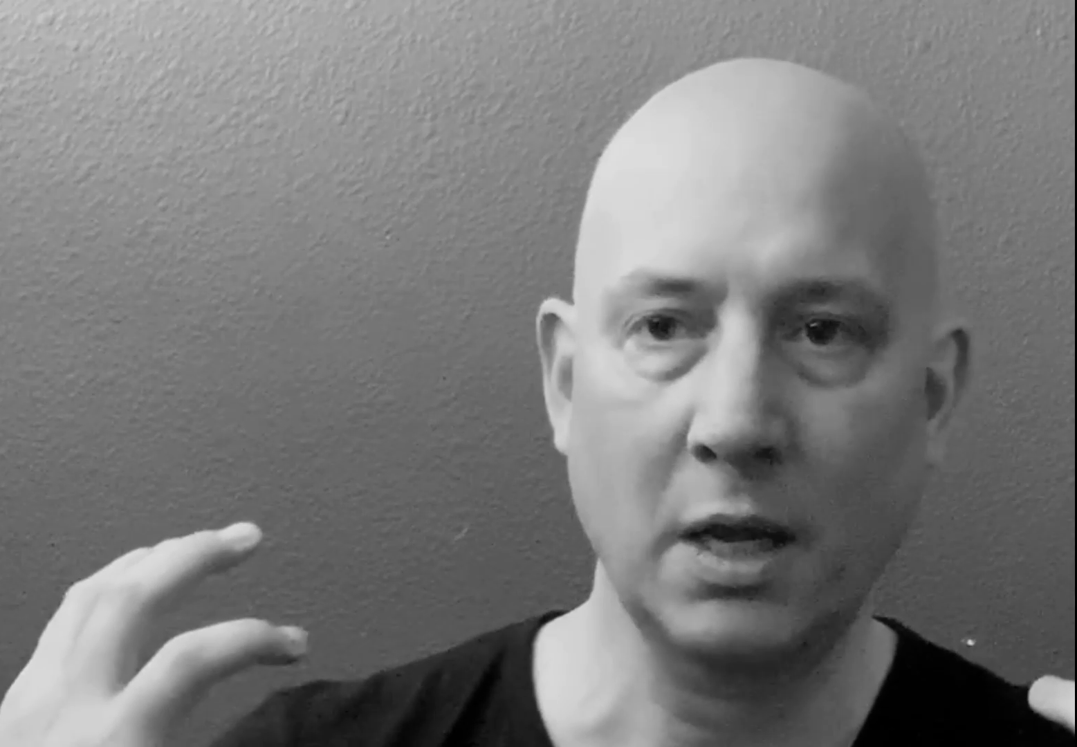
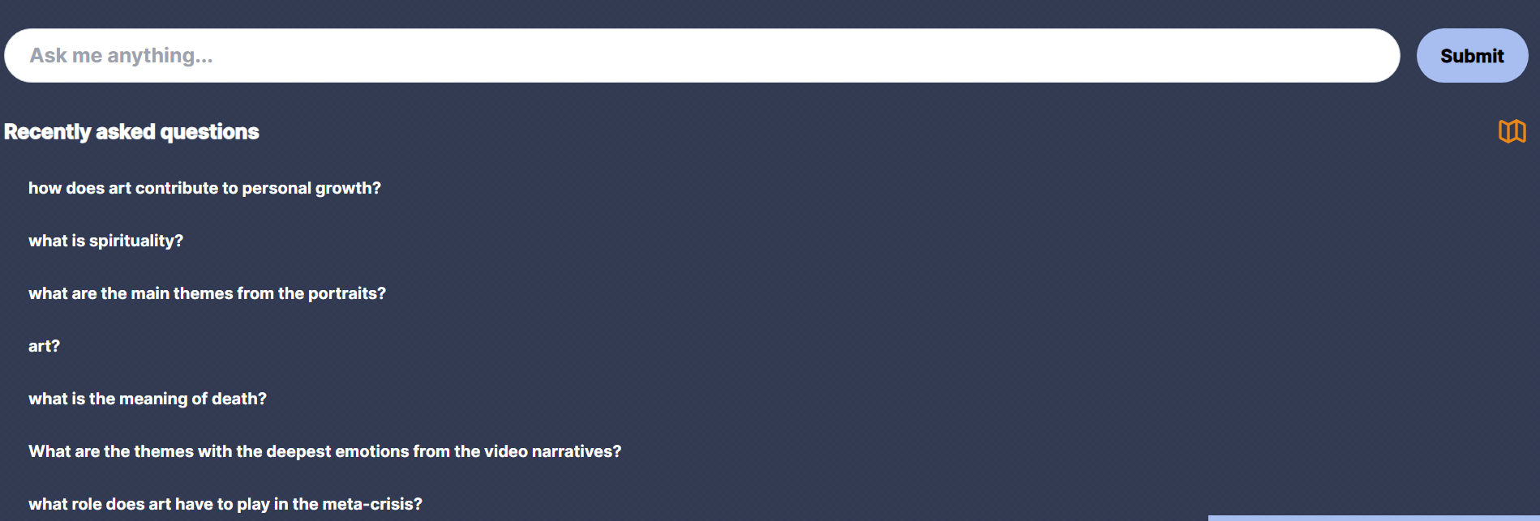
Ask InteriorTruth

Slide 18

Art’s Role In Our Polycrisis
NOTION AI:
Art has always been a powerful means of expression, a tool to communicate ideas and emotions that words alone cannot fully convey. In today's world, marked by social and environmental crises, the role of the arts is more significant than ever.
Art is a mirror held up to society. It reflects our joys and sorrows, our triumphs and failures. It can also act as a catalyst for change. In the midst of social upheaval, artists often use their work to draw attention to societal issues, to challenge prevailing norms, and to inspire action. Art can give voice to the marginalized, illuminate the experiences of the oppressed, and provoke conversations about issues such as inequality, discrimination, and social justice.
In the context of environmental crisis, art can serve as a powerful tool to raise awareness about the threats facing our planet. From photography that captures the stark reality of climate change, to installations that highlight the beauty and fragility of the natural world, art can make the abstract tangible and spur individuals and communities to action.
In these troubled times, the arts can provide a beacon of hope, a source of comfort, and a platform for dialogue and action. Through painting, music, dance, literature, and other forms of artistic expression, we can explore our shared humanity, confront our challenges, and imagine a more equitable and sustainable future.

Slide 19

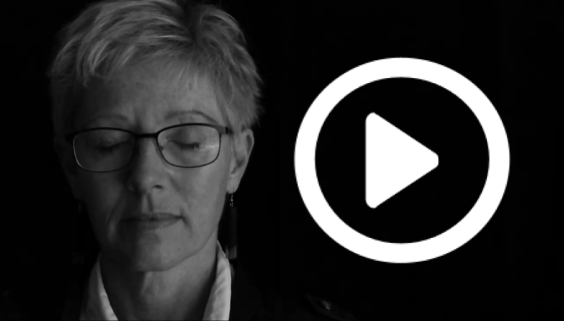
Art’s Role In Our Polycrisis
InteriorTruth Data Set + GPT AI:
Art plays a crucial role in addressing the meta-crisis by acting as a bridge between individuals and fostering a sense of connection, especially during times of isolation [1].
Through sensory engagement, art helps us understand and address complex, interconnected issues such as economic inequality, climate change, and social injustice by fostering empathy and inspiring innovative solutions [2].
By giving voice to the unheard and shedding light on societal issues, art serves as a catalyst for change and encourages dialogue [3].
Artists extend an invitation to others to see, feel, and experience the world in new ways, thereby challenging preconceptions and fostering deeper connections [4].
This holistic engagement through art allows us to perceive the interconnectedness of things, enabling a more intuitive and profound understanding of the world [5].
Art also serves as a powerful tool for expressing unique perspectives and conveying ideas that might be difficult to communicate through other mediums, thereby broadening our understanding of reality [6].

Slide 20
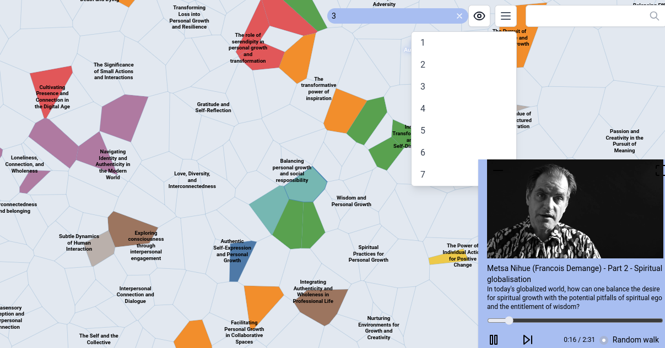

Slide 21
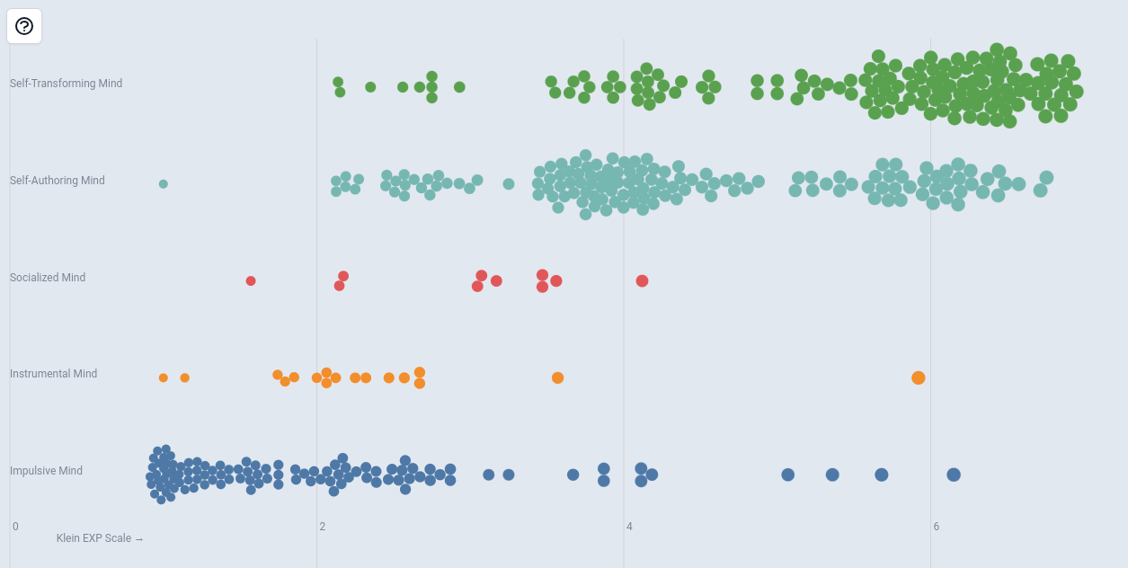
Ego Construct (Kegan)
Level of Focusing (Klein/Gendlin)

Slide 22
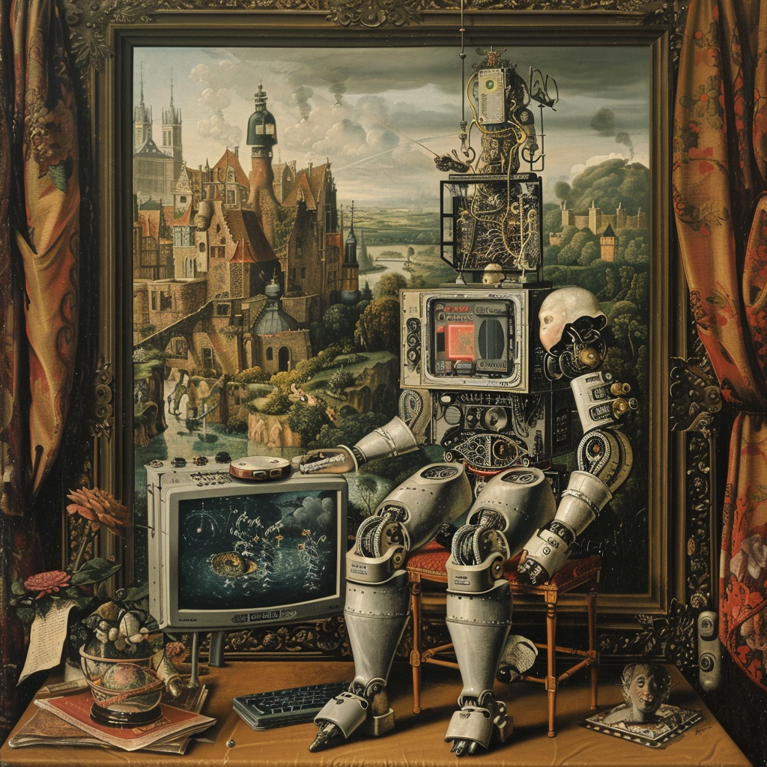
www.tyler.world/ai

Slide 23
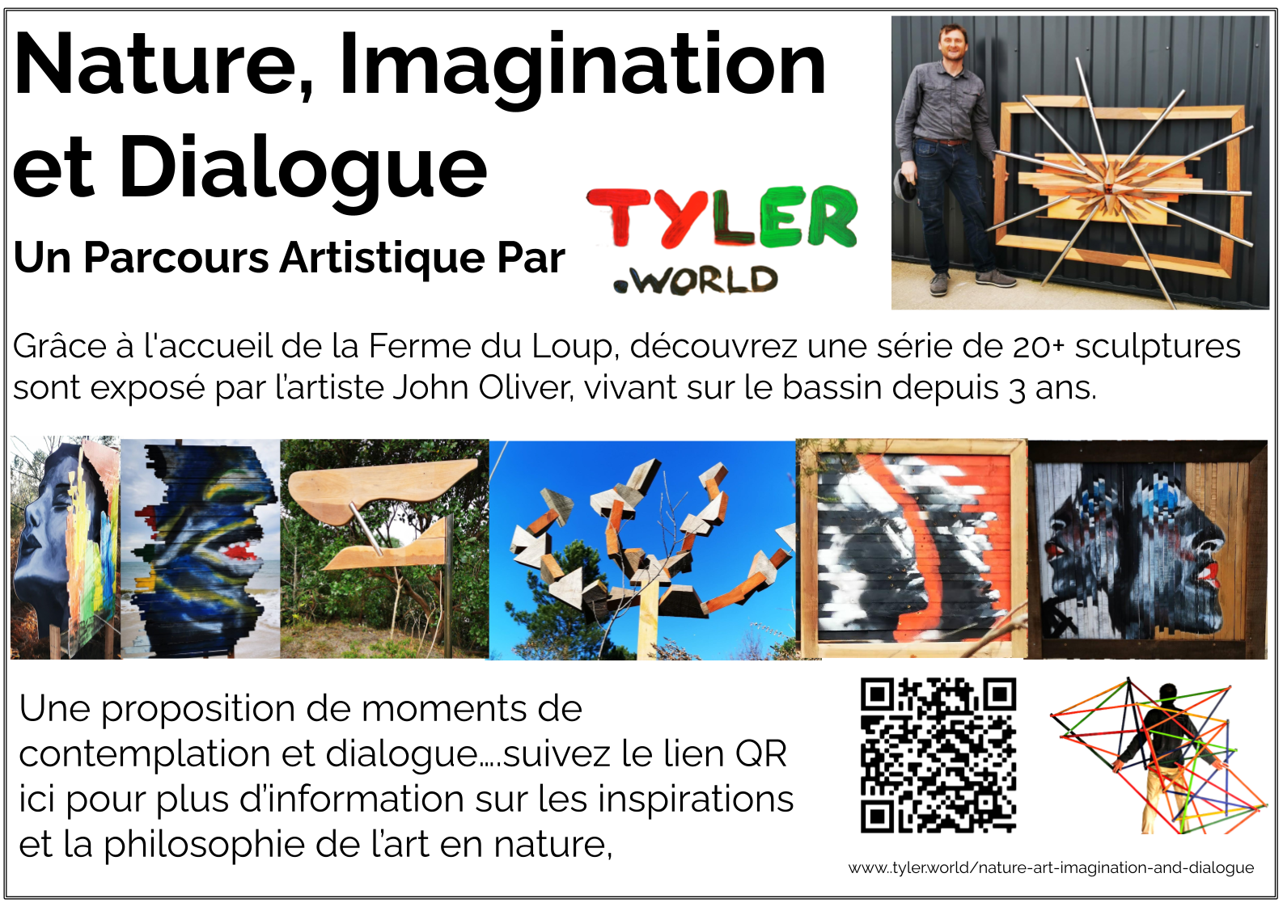

Slide 24
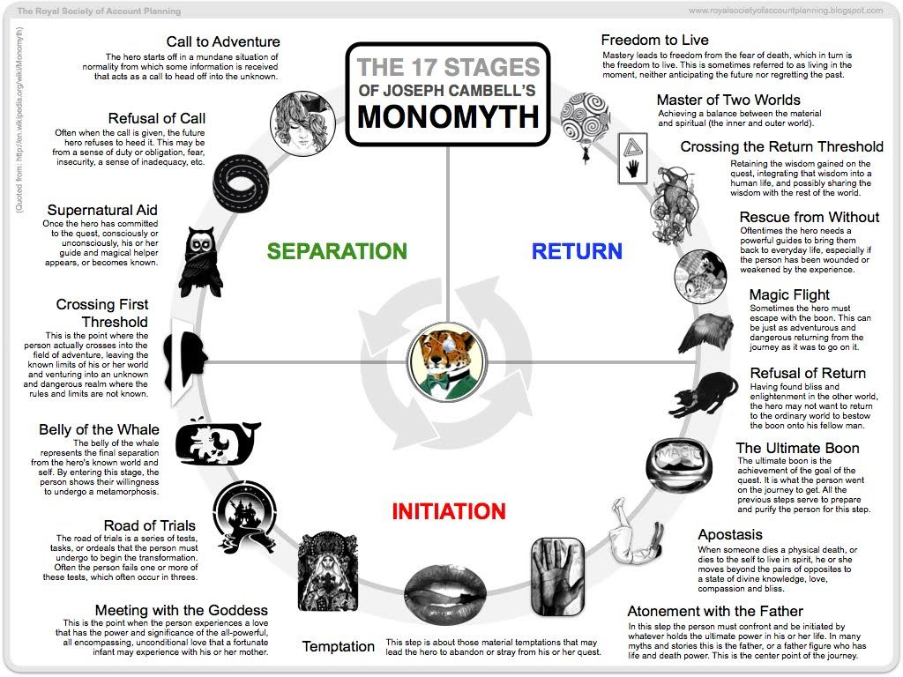

Slide 25
Annex Slides

Slide 26
How can we make conflict beautiful?
The aesthetics of dialectics

Slide 27
Arts As Divergence

Slide 28
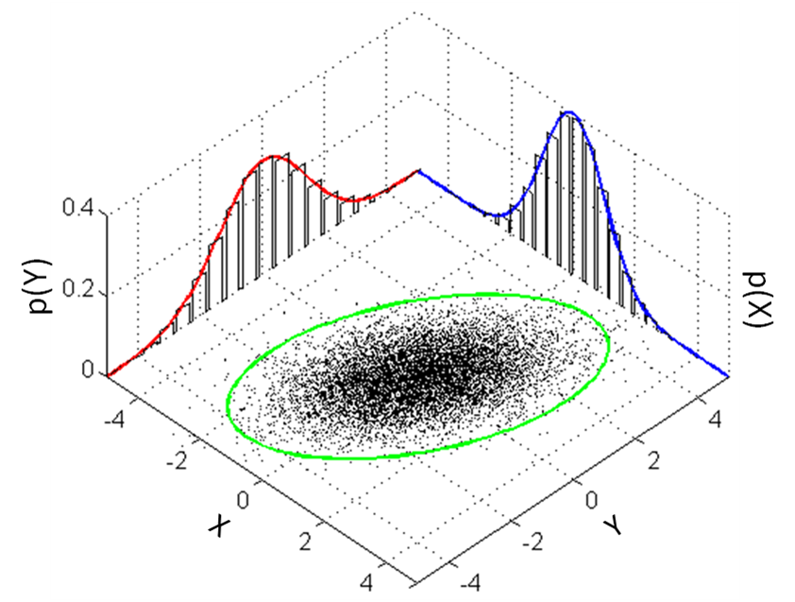
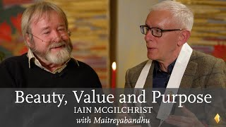
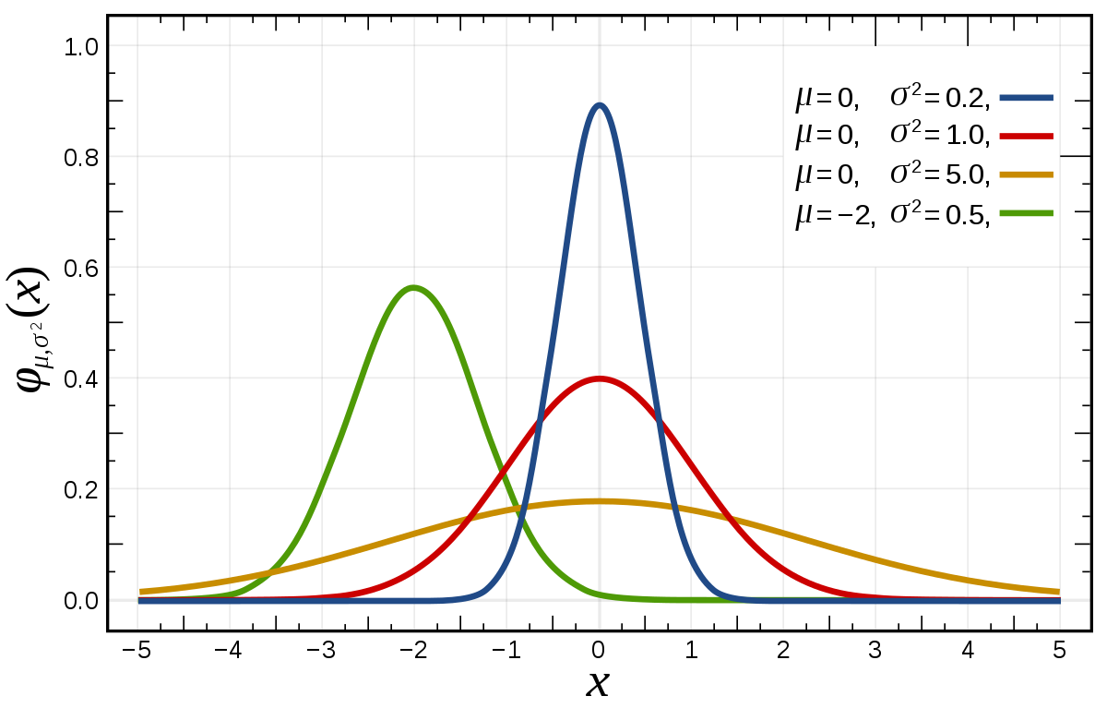
Non-Linearities
“There is an unknowing the other side of ignorance which is far superior to both knowing and ignorance
There is an innocence the other side of experience which is superior to both experience and naivety
And the other side of folly which is superior to both folly and common sense”
Dr Iain McGilchrist in conversation with Jnanavaca about 'Beauty, Value & Purpose'
Notes:
Experience versus naivety
Knowing versus ignorance
Folly versus common sense

Slide 29
Correlating Artistry to Complexity Capacities

Slide 30
INTEGRATED ARTISTRY
Artistry - Across Complexity and Creative Consciousness
Being
Complexity Skills | Artistry
 | Synchronicity - trusting accidents
Facilitation for Emergence | Surrender
Novelty as leverage | Beginner's mind - cycling ego
Sensing the whole | Syncretic cognition (Ehrenzweig)
 | Doses of craziness
Notes:
Alfred Gell - The Technology of Enchantment and the Enchantment of Technology
Peter Merry - Leading from the Field
Tim Ingold -
John Berger
Tessa Adams - THE WORK OF TRANSFORMATION: THE SEDUCTION OF THE BROKEN OBJECT, BRITISH JOURNAL OF PSYCHOTHERAPY (1998) 14(4)
Richard Sennett -
Anton Ehrenzwieg - The Hidden Order of Art

Slide 31
INTEGRATED ARTISTRY
Artistry - Across Complexity and Creative Consciousness
Seeing (and meaning making)
Complexity Skills | Artistry
Weak signal detection | Small noticings - magic from mundane
Polarity navigation | Holding contradictions
Narrative sensemaking | Working with symbolism and signifiers
Transcontextual | Perspective shifts - eclecticism
Anthropological principles - the only model of the system, is the system itself | Participant observer (Ingold)
 | Construct aware - creative process as object (post-modern art onwards)
Pattern recognition | Abductive (vs. deductive and inductive) cognition
Measuring vectors (vs. coordinates) | Movement
 | Remembering
Notes:
Alfred Gell - The Technology of Enchantment and the Enchantment of Technology
Peter Merry - Leading from the Field
Tim Ingold -
John Berger
Tessa Adams - THE WORK OF TRANSFORMATION: THE SEDUCTION OF THE BROKEN OBJECT, BRITISH JOURNAL OF PSYCHOTHERAPY (1998) 14(4)
Richard Sennett -
Anton Ehrenzwieg - The Hidden Order of Art

Slide 32
INTEGRATED ARTISTRY
Artistry - Across Complexity and Creative Consciousness
Doing
Complexity Skills | Artistry
 | Working with the “Field” (Merry)
 | Connecting to source (Jaworski)
Safe-to-fail experiments | Art as constant error correction (Berger)
 | Creative destruction (Adams)
Ritual dissent | Transgression - the fool, the clown
 | Art as technology (Gell)
Following heuristics (“rules of thumb”) | Life-Art and Ritual as technology (Jonathan Harris)
 | Craft (Sennett)
 | NOT knowing what you are doing
Notes:
Alfred Gell - The Technology of Enchantment and the Enchantment of Technology
Peter Merry - Leading from the Field
Tim Ingold -
John Berger
Tessa Adams - THE WORK OF TRANSFORMATION: THE SEDUCTION OF THE BROKEN OBJECT, BRITISH JOURNAL OF PSYCHOTHERAPY (1998) 14(4)
Richard Sennett -
Anton Ehrenzwieg - The Hidden Order of Art

